Slide 1
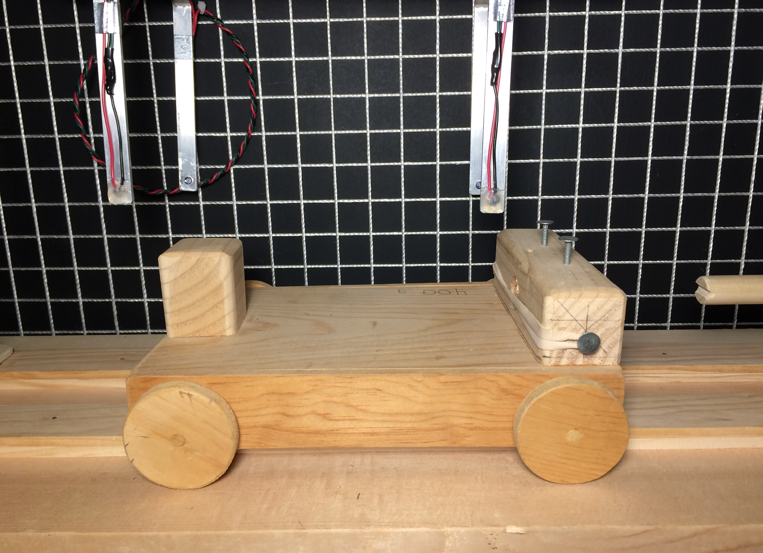
Friction 2
Rolling Objects
Practice Problems
LabRat Scientific
© 2018

Slide 2
Calculate the frictional force acting on a 10.0 N wagon that has a dynamic coefficient of friction of 0.3.
Dynamic Friction = Normal Force * Dynamic Coefficient of Friction
= 10.0 N * 0.3
= 3.0 N

Slide 3
For the system shown below, what is the load (pulling force) required to keep the cart moving at a constant velocity once it is given an initial impulse?
μ_{Dynamic} = 0.04
Wt = 3 N
Load = ?
The first step is to determine the dynamic friction force acting on the cart:
Friction Force = Weight * Coefficient of Friction
= 3.0 N * 0.04
= 0.12 N

Slide 4
For the cart to move at a constant velocity once an impulse has been applied, Newton says the sum of the external forces needs to be zero. This means that the tension in the string pulling on the cart (a.k.a. “load”) needs to be equal to the frictional force:
Load = Friction Force
= 0.12 N

Slide 5
A cart with a weight of 2.0 N and a coefficient of static friction of 0.05 (relatively high for a wheeled object) is placed on an inclined plane. As the plane angle is increased, at what angle will the cart begin moving?
As the incline angle is increased, the normal force acting perpendicular to the plane will begin to decrease. This also means the frictional force holding the cart in place is also decreasing. At the same time, the tangential force, which is acting along the track, will begin to increase. At some point, the tangential force trying to pull the cart along the plane will overcome the frictional force and the cart will begin to move.
The first step is to draw the Free Body Diagram in order to keep the forces and associated equations straight. Then, since the problem will be iterative which means a small angle is assumed and calculations are made. If necessary, a slightly large angle is then assumed and the calculations are repeated… This is repeated until the force along the track becomes greater then the friction force.

Slide 6
ϴ
Force_{N} = Wt * Cos (ϴ)
Wt
ϴ
Force_{T} = Wt * Sin (ϴ)
The normal force and the coefficient of friction dictate the frictional force holding the cart in place. The tangential force is the force trying to pull the cart along the track.

Slide 7
This iterative process can take some time. Luckily spreadsheets were developed that makes this iterative process much faster. And example of a spreadsheet is given on the next slide.
There are other LabRat Modules that discuss how to use spreadsheets to write iterative simulations. Use the equations provided at the end of this lesson to make your own simple iterative spreadsheet.

Slide 8
The crossing point of the tangential force and friction force is where the cart will start rolling down the incline. This is about 5 degrees

Slide 9
Equations Used in Spreadsheet
Angle_{Radian} = Angle_{Degree} * 0.01745
Normal Force = Weight * Cos (Angle_{Radian})
Tangential Force = Weight * Cos (Angle_{Radian})
Friction Force = Normal Force * Static Coefficient

